Slide 1
METHODOLOGICAL RECOMMENDATIONS FOR USING THE MODELS OF NATURAL SCIENCES CONCEPTS
Uldis Heidingers
Mg.sc.ing., PIKC «Rīgas Valsts tehnikums» skolotājs

Slide 3
1. option“'A MODEL AS A MATERIAL FOR ILLUSTRATING THE TEACHER'S NARRATION' ”

Slide 4
Choice of pictures
A polar covalent bond
A non-polar covalent bond

Slide 5
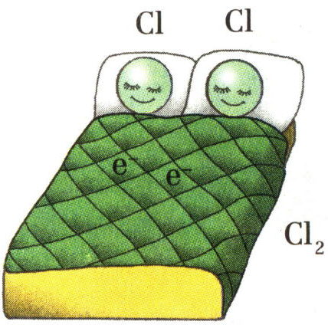
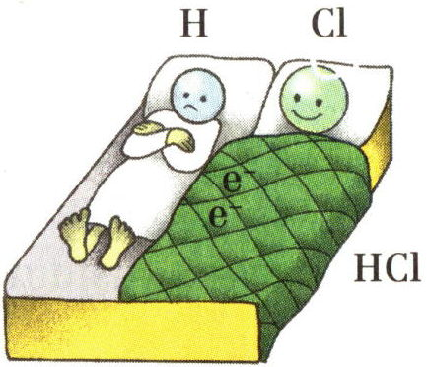
Attēlu izvēle
Polārā kovalentā saite
Nepolārā kovalentā saite

Slide 6
The 2nd option “CREATION OF A MODEL AS A HOME-WORK ”

Slide 7
Essential:
useful as a way of getting a reflexive link;
students must understand differences between the model of the concept and the example in the form of a drawing or picture.
;

Slide 8
Essential :
the task must be clearly defined;
motivating assessment must be implemented;

Slide 9
Essential:
not always the explanation is useful when demonstrating the models created by other students;
finding 'key 'words in the explanation of the concept is helpful.

Slide 10
Term - «………..»
Definition Find the definition of this term in 2 different sources and write them down here | Visual association Think what association with everyday life or nature the information included in the definition causes.Insert a picture here | Description of association in words Formulate your association in words.Write the discription here

Slide 11
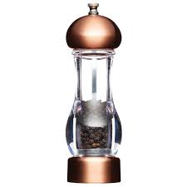
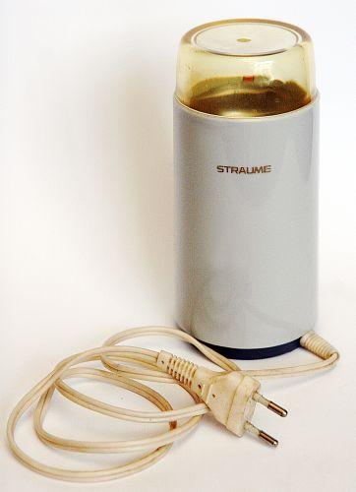
Term - «Analogus organs»
Definition Organs that perform similar functions but are of different origins are analogus organs. (https://www.siic.lu.lv/bio/IT/B_10/default.aspx@tabid=9&id=172.html). Organs of animals or plants that perform similar functions bur are of differnet origins and constructions. (https://lv.oxforddictionaries.com/skaidrojums). | Visual associations | Descriptions of associations in words Electric coffe-mill and a hand operated grinder consists of differnet parts.But both gadgets are used for grinding/coffe or pepper/It means they perform a similar functions.The same as analogous organs .

Slide 12
3rd option“Creating model during the lesson”

Slide 13
Essential:
can be done during the lesson in the stage of acquiring the new material;
can be done only then if the students have already got some experience in making models.;

Slide 14
Essential:
successful when working in groups;
The teacher must do some pre-preparation- setting the task, making some collage of pictures, choosing the sources of information.

Slide 15
The 4th option 'ANALYSIS OF MODELS' /1/

Slide 16
Essential:
can be carried out if the acquired material contains some concepts that have been taught before in some other subjects;
successful when working in groups;
interaction of the teachers of both subjects.

Slide 17
The 5th option ' ANALYSIS OF MODELS'/2/

Slide 18
Essential:
can be carried out if it is necessary to update the concepts acquired relatively not long ago but needed for the new theme;,
can be used in the opening part of the lesson as a discussion conducted by the teacher.

Slide 19
The 6th option ' ASSESSMENT OF MODELS'

Slide 20
Essential:
can be used at the final stage of the theme summing up the acquired material within a particular theme and preparing for the final test;
very useful if a lot of concepts must be acquired within the theme;

Slide 21
Essential:
strict criteria of assessment must be worked out in order to give assessment points; ;
successful when working in groups;

Slide 22
Essential:
each group assesses several models of the same concept and choose the most successful;;
the teacher conducts presentations of group opinion stressing the needed accents to secure correct understanding of the concept.
.

Slide 23
Golden' rules of assessment:
ask;
praise;
offer!!

Slide 24
ACTIVITY 'PLANNING THE LESSON'»

